Slide 1
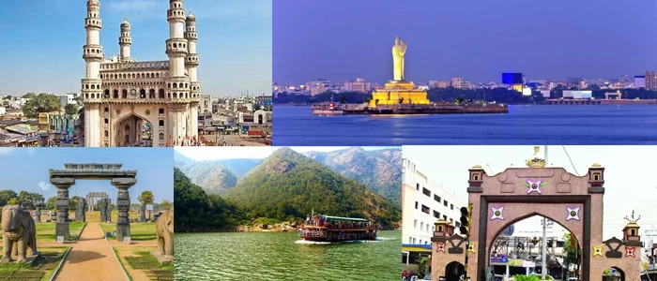

Slide 2
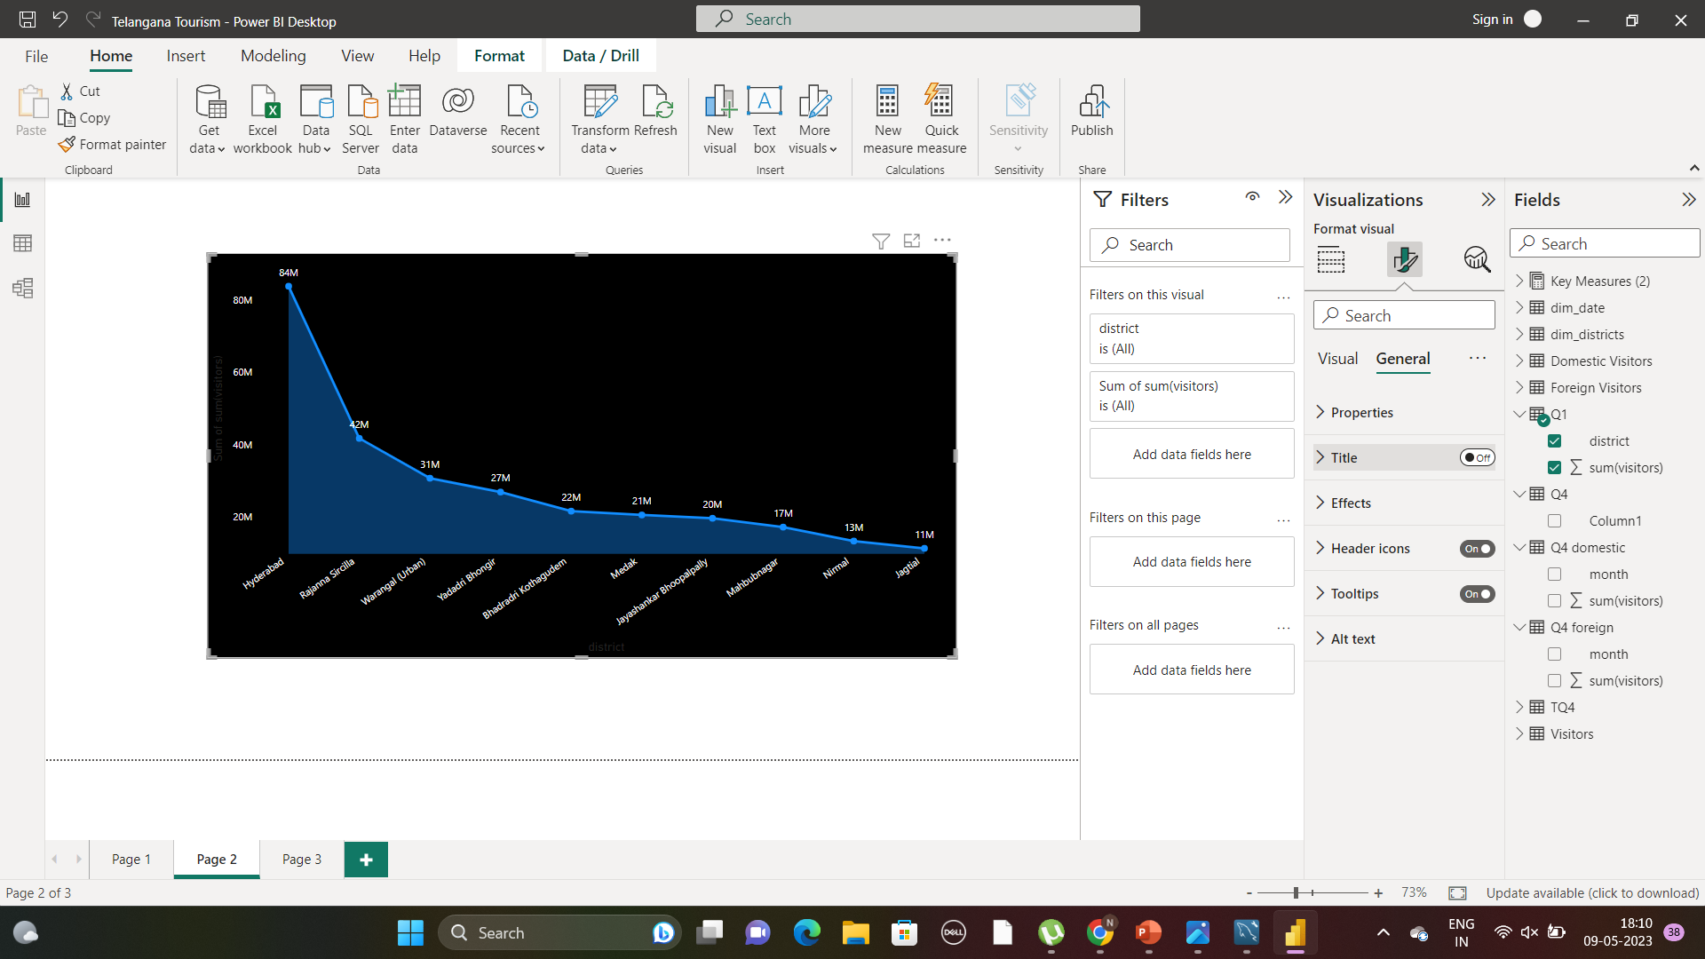
Top 10 Domestic Visitors Districts-2016-2019
Hyderabad attracted
Visitors twice the rest of the city
Jagital just attracted less than 2 % of visitors of Hyderabad
But it is high in annual growth rate of domestic tourist than hyderabad

Slide 3
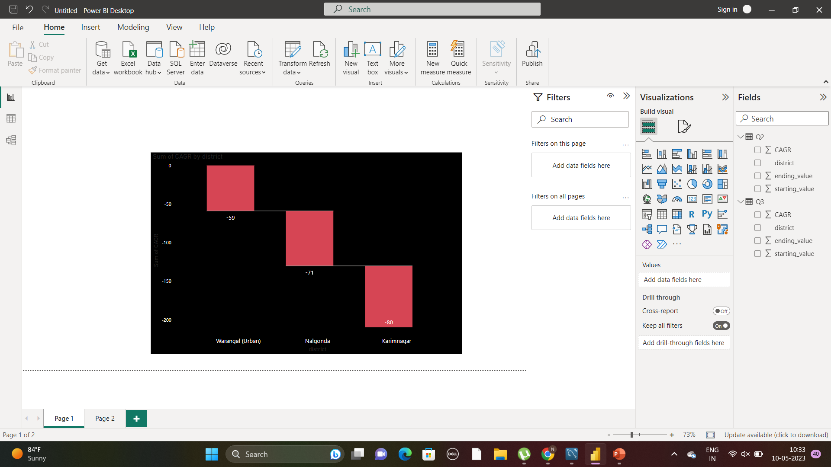
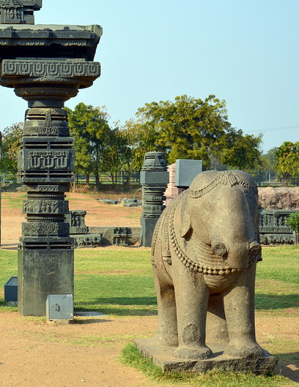
Bottom 3 Districts-CAGR(2016-2019)
Warangal(urban) should do some creative infrastructure for tourist.
River Rafting in Manair River can attract more people especially foreigners to Karimnagar

Slide 4
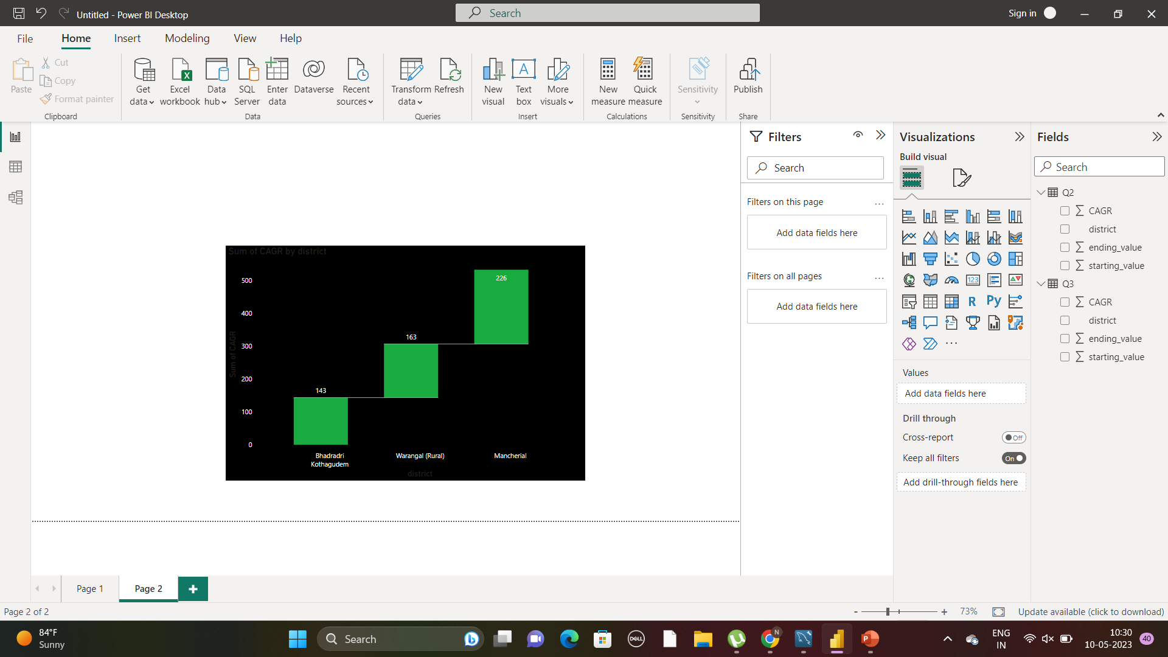
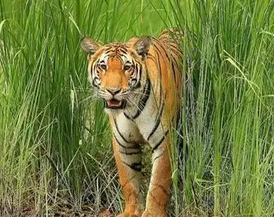
Top 3 Districts-CAGR(2016-2019)

Slide 5
Peak and Low seasons months for Hyderabad District from 2016-2019
Domestic Visitors
June & December are the peak months
March & February are the low months
Lucky Give Aways
Awesome Offers
Family Package
Foreign Visitors
November to February are the peak months due its pleasant climate
April to June are the low months
Foreigner’s friendly hotel
Creative adventurous games

Slide 6
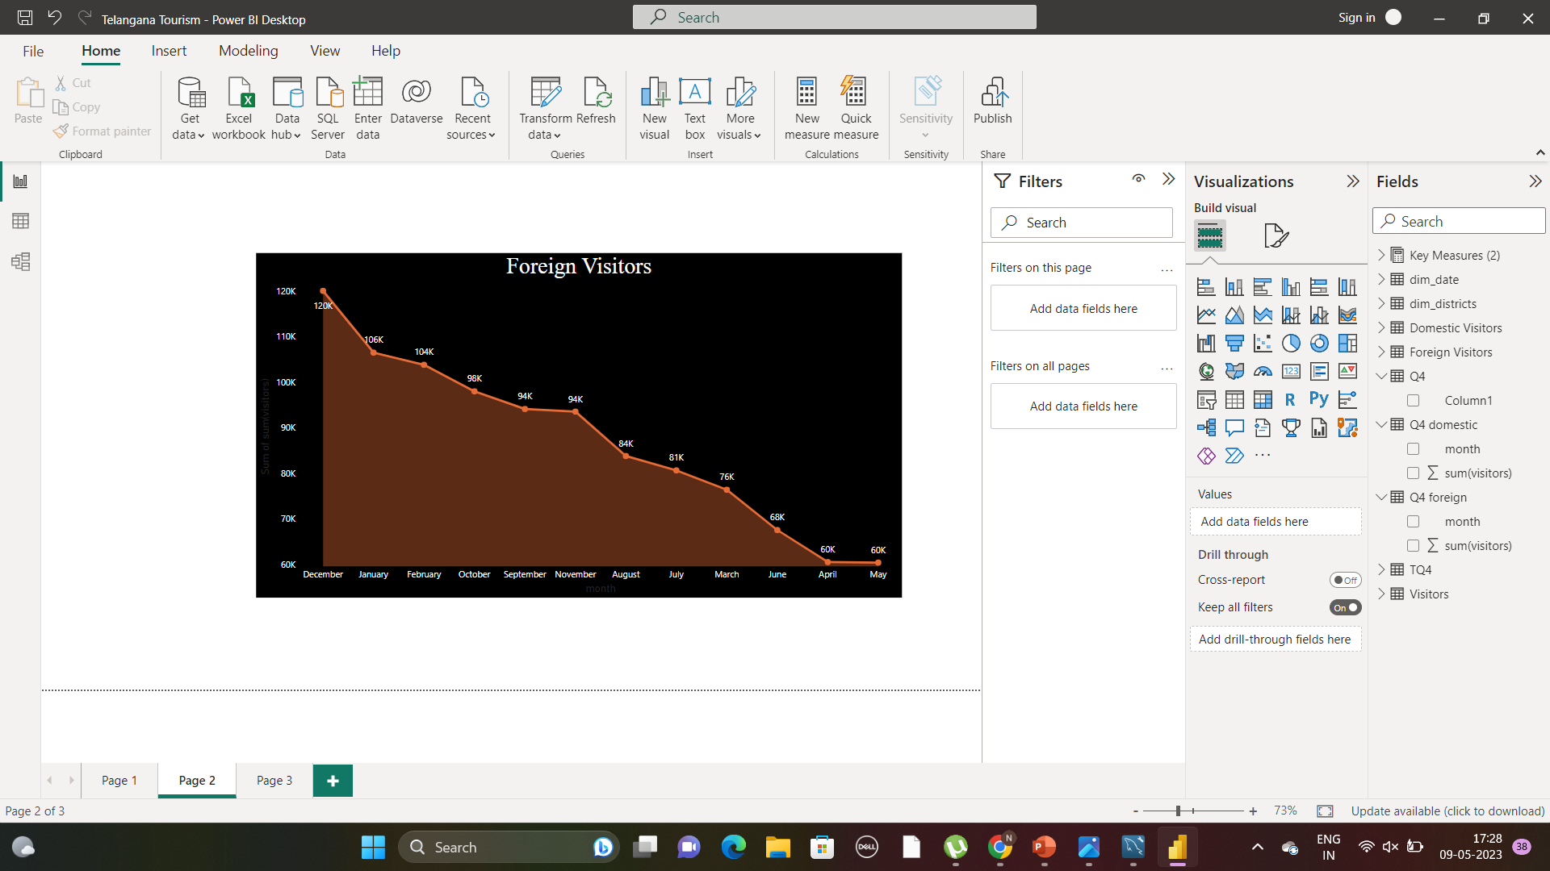
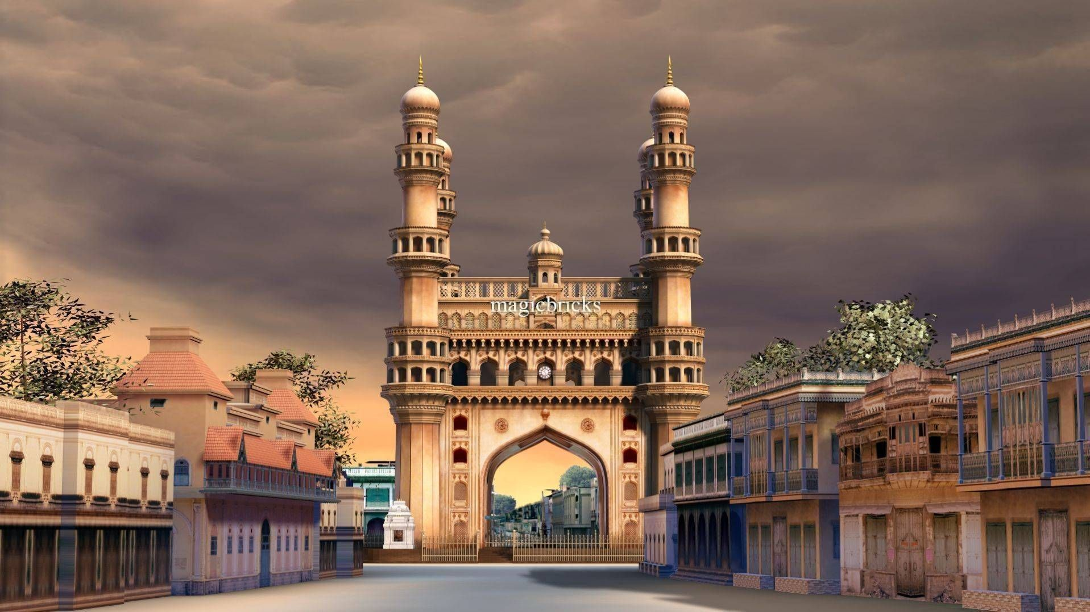
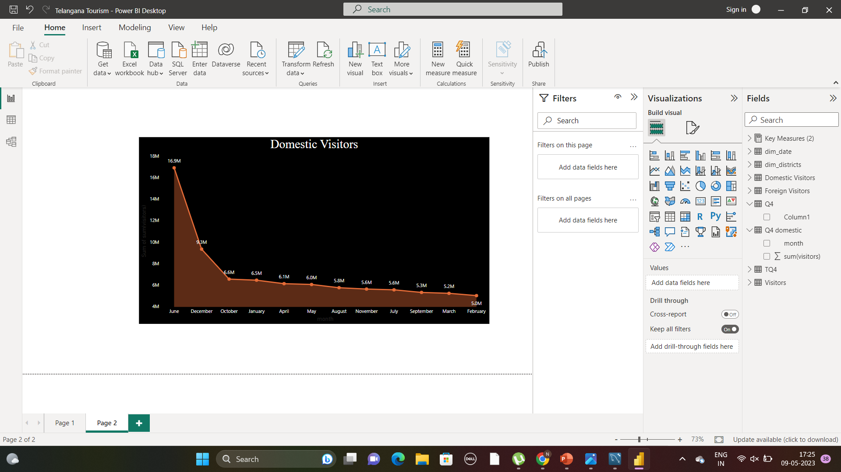

Slide 7
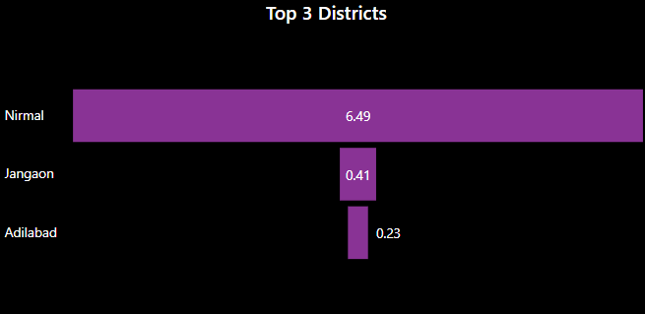

List of Districts-Ratio of Domestic
Visitors to Foreign Visitors
Hyderabad is attracting highest tourist both from domestic and foreigners, but foreigners are relatively more
Nirmal is attracting relatively more domestic tourist than foreign tourist

Slide 8
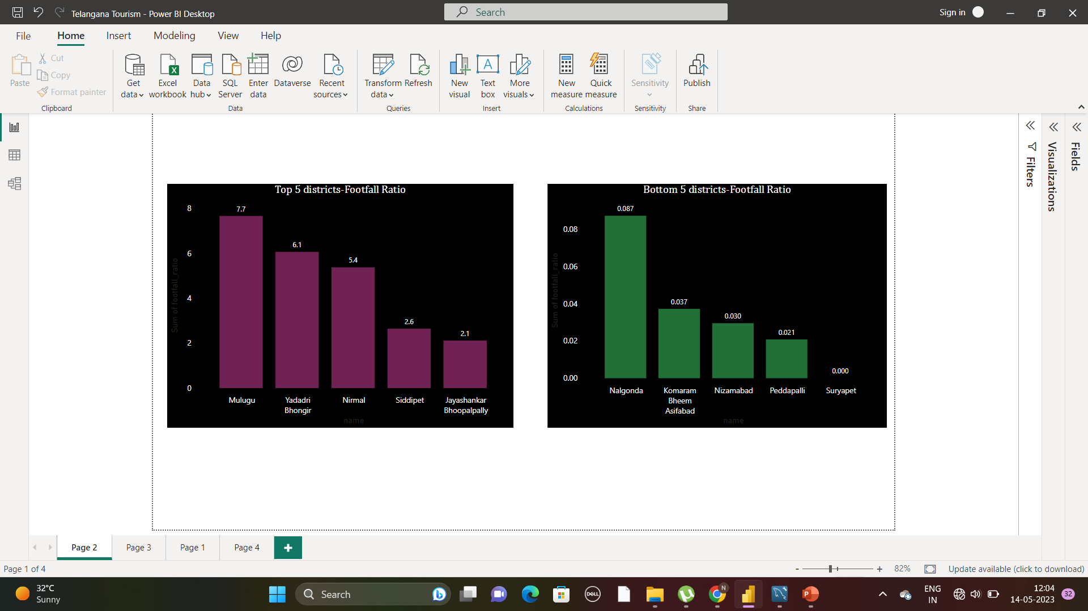

Districts - Footfall Ratio in 2019
Footfall ratio :Total Visitors/Total Residents Population
High Footfall ratio in mulugu said that the local infrastructure is strained by tourist visits
Low Footfall ratio in mulugu said that the local infrastructure is not fully utilized to its potential by tourist visits

Slide 9
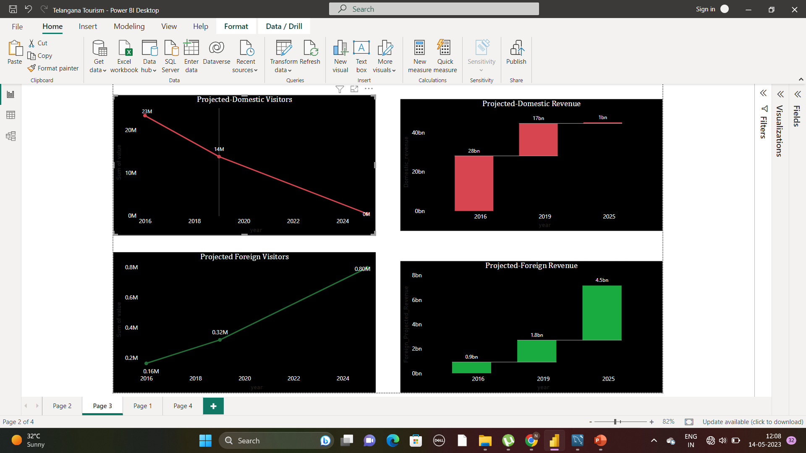
Hyderabad-Projected Domestic Visitors & Revenue -2025
Hyderabad is declining in attracting domestic tourist

Slide 10
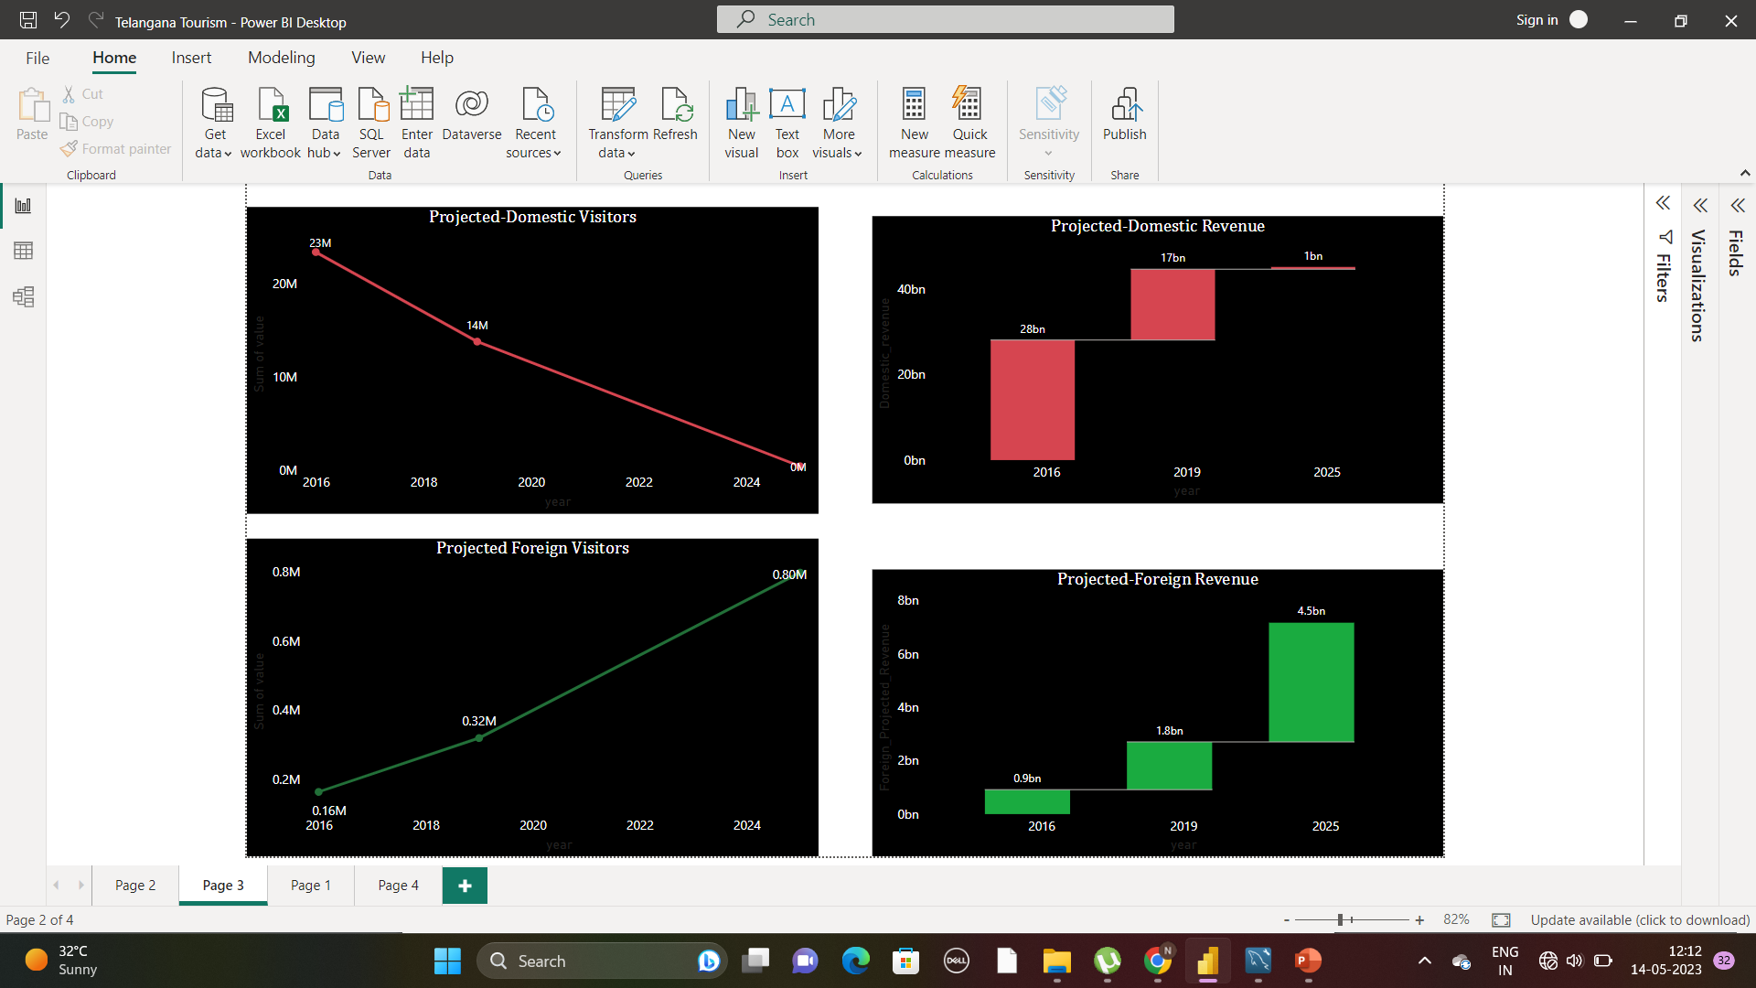
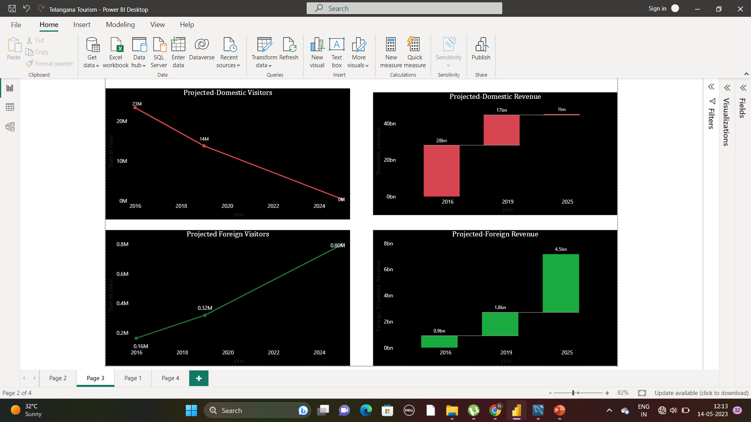
Hyderabad-Projected Foreign Visitors & Revenue -2025

Slide 11
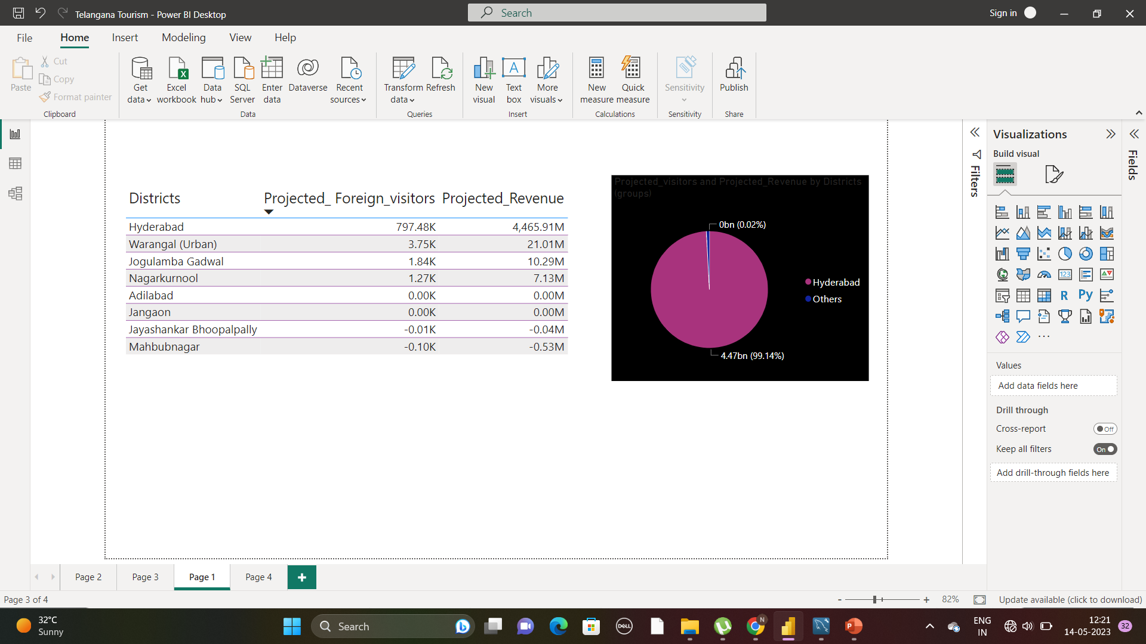

Projected Foreign Visitors & Revenue -2025
Hyderabad Itself will receive more tourists and accounts for 99% of revenue from foreign visitors in Telangana

Slide 12
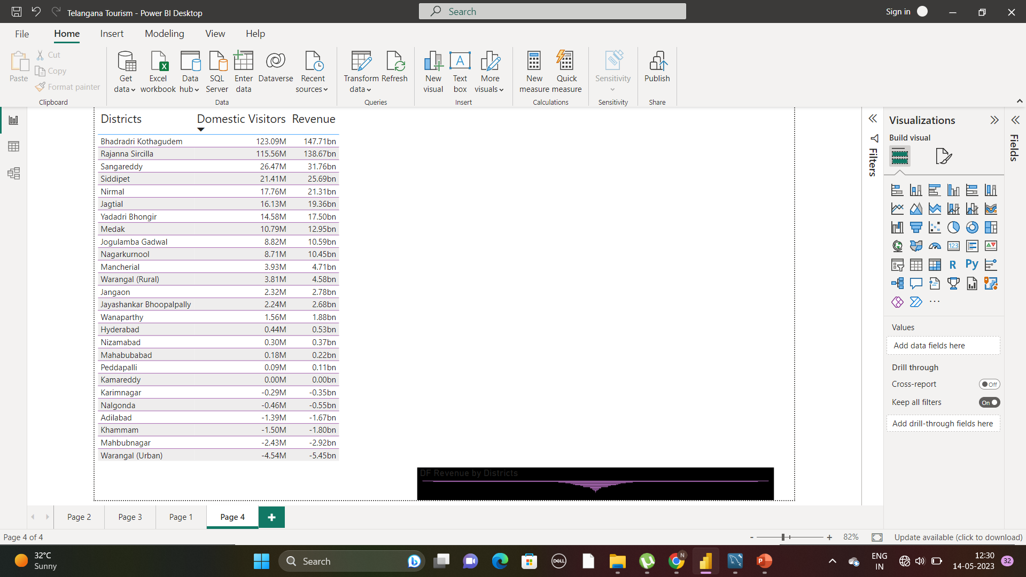
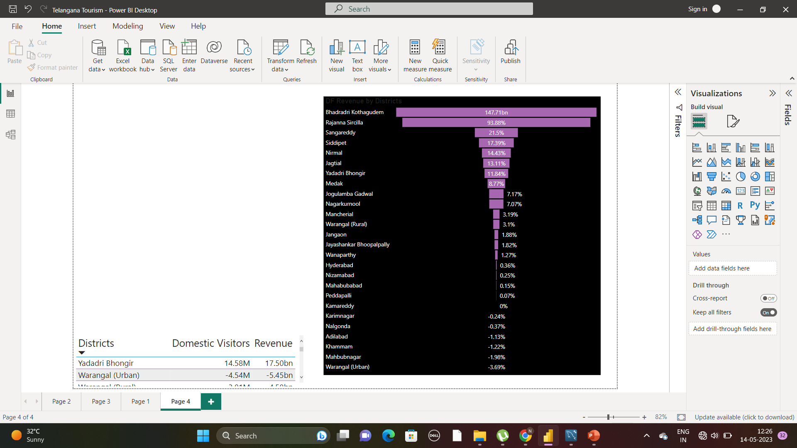
Projected Domestic Visitors & Revenue -2025
Bhadradri Kothagudem and Rajanna attract more domestic tourist and account for more than 60% of revenue

Slide 13
Most Potential Districts
Hyderabad-As it is saturates with historical monuments it has more potential to attract foreign tourist
Nirmal-Though it at second last visitors , its CITY OF FORT identity such as Soan garh, Nirmal Fort, shyam garh, battis garh. To make it more potential we can use the SOUND AND LIGHTS EFFECTS ON FORTS like Golconda fort, Warangal fort here too
Mancherial- Gudemgutta Sri Satyanarayana Swami Temple is a noted pilgrim centre in the district.
Kawal tiger reserve attracts more visitors
Rajanna Siricilla- Its growth is also make an siricilla as textile hub. Ananthagiri Fort,
Siricilla textile Park, Lakshmi Narasimha swamy Temple
SanagReddy-Heritage, Jail Museum, GottamGutta waterfalls, Archaeological Museum

Slide 14
Events – Government can conduct
CULTURAL
FESTIVAL
WELLNESS
RETREATS
ADVENTURE
SPORTS
EVENT
FILM
FESTIVAL
HERITAGE WALK
FOOD
FESTIVAL

Slide 15
Events Explanation
Food Festivals
Adventure Sports
Telangana Food Festival -Hyderabad
Rayalaseema Ruchulu Food Festival - Hyderabad
Telangana Food and Brew Festival - Hyderabad
Kakatiya Food Festival -Warangal
Kondapochamma Sagar Trekking and Camping - Hyderabad
Pocharam Wildlife Safari and Trekking - Medak
Bhongir Rock Climbing- Yadadri Bhuvanagiri district
Nagarjuna Sagar Water Sports - Nalgonda
Film Festivals
Wellness Retreat
Hyderabad International Film Festival - Hyderabad
Telangana Bengali Film Festival - Hyderabad
Telangana State Film Festival -Hyderabad
Cinema of Resistance Film Festival - Hyderabad
Ananda Lahiri Retreat- Hyderabad
Yoga and Meditation Retreat - Khammam
Wellness and Spiritual Retreat - Warangal
Ayurveda and Spa Retreat - Hyderabad
Heritage Walk
Charminar Heritage Walk in Hyderabad
Golkonda Fort Heritage Walk in Hyderabad
Warangal Fort Heritage Walk in Warangal
Khammam Fort Heritage Walk in Khammam

Slide 16
Cultural Festivals-Districts-Months
Bathukamma Festival- Telangana- specifically Hyderabad and Warangal in July-August Month
Sammaka Sarakka Jaathara-Tribal festival- February month-Warangal
Peerla Pandunga-Secular festival in Muharram month
Dandaadi-Gusaadi festival – Adivasis dance in Adilabad –October Month
Bonalu & Kakatiya festival -Warangal-July-August Month
Bheemalpen festival-Gond tribe beat drums at kuntala falls in Adilabad
Deccan Festival – Hyderabad- February
World Tourism Day- a long day expo at HITEX EXHIBITION CENTRE- Hyderabad

Slide 17
Can Hyderabad emulate Dubai model of Tourism??
As Dubai has invested heavily in building world-class infrastructure, such as the Burj Khalifa and Palm Jumeirah, as well as creating unique attractions like indoor skiing and a massive shopping mall.
Hyderabad is also strong in :
Historical monuments
Ramoji Film City
Cultural Festivals
Crafts - Bidri ,Banjara needles craft
Boating- HussainSagar, NizamSagar
River Cruise-Hyderabad To Amaravthi
Tour Package –Hyderabad- Somasila- Siricilla road -river cruise
Hyderabad Heritage City –Museum Tour
Temple Tour
Dubai's strategic location, tax-free business environment, and world-class infrastructure have made it a popular destination for business conferences and events, which in turn drives tourism.
Hyderabad can also follow the Dubai's Business marketing cum Tourist strategy with its uniqueness as foundation

Slide 18
Recommended measures to develop tourism
Collaborate with private players
Develop MICE tourism: Business meetings, Incentives, conferences, Exhibition by building Convention Centres and Exhibition hall
Expand public Infrastructure: As High footfall ratio will crowd over small infrastructure that may lead to less tourist visits because of congestion
Palace Tour: Ramoji film city model can be replicated to stay and enjoy the forts and palaces
Develop eco-tourism: Hyderabad has many natural attractions such as lakes, forests, and wildlife reserves. The government can develop eco-tourism by promoting these attractions and creating necessary infrastructure such as nature trails, campsites, and wildlife observation decks
Tourism Advertisement at International World Market

